Slide 1
UP ELECTIONS 2017 SENTIMENTAL ANALYTICS AND PREDICTION

Slide 2
PROJECT OVERVIEW
This project included downloading twitter data into R and performing analysis. The steps involved are: • Organizing the data and removing Stopwords, punctuations • Creating a glossary to monitor Hindi and English words • Structuring barplots and Wordcloud to identify the most commonly used words • Identifying positive and negative words and drawing trend lines to realize their usage and rate of recurrence in twitter data • Preparing a report on the conclusion and forecasting a winner based on the analysis

Slide 3
ELECTION LANDSCAPE
Following parties were included for the election landscape as they play a pivot role in elections:
Bharatiya Janata Party(BJP)
Indian National Congress+ Samajwadi Party (INC+SP)
Bahujan Samaj Party (BSP)
Predictions are made by analyzing approx. 20K tweets all taken together at various instance of time.

Slide 4
R-ANALYSIS

Slide 5
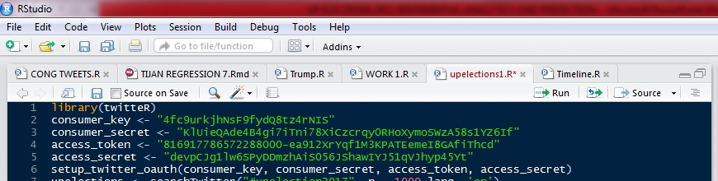
Setting Twitter Authentication
A twitter application by the name of “ ” was created and the necessary keys were generated. Using the R package “twitteR” we set up the necessary authentications for importing the twitter data into R environment.

Slide 6
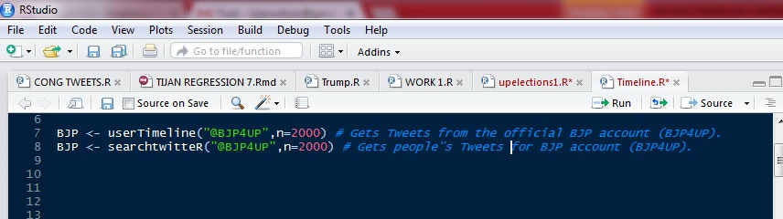
IMPORTING TWEETS :

Slide 7
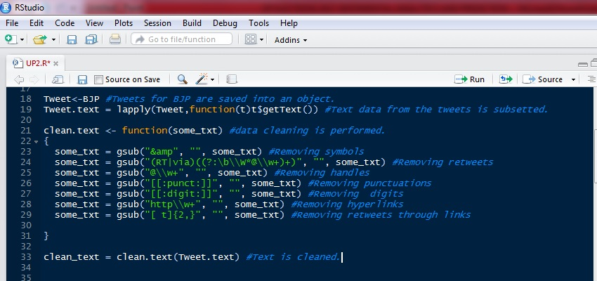
CLEANING THE DATA :

Slide 8
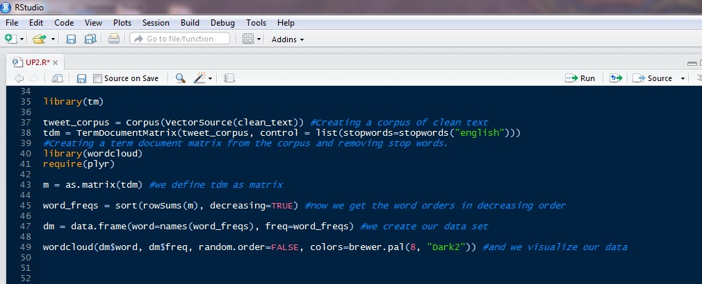
WORDCLOUD CREATION :

Slide 9
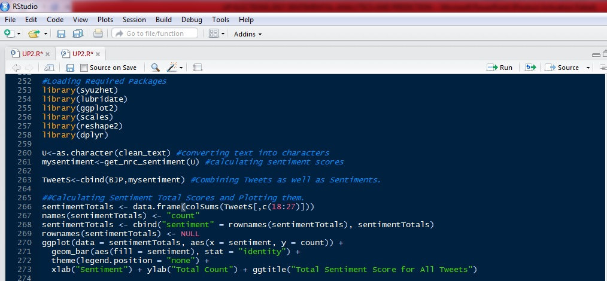
SENTIMENTAL SCORES :

Slide 10
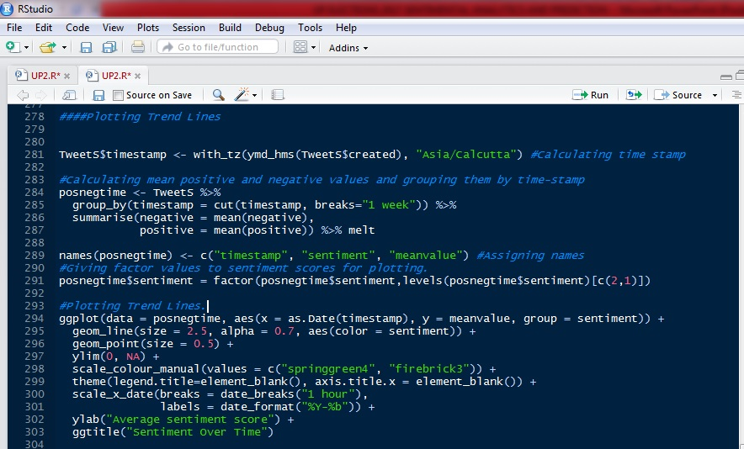
TRENDLINES :

Slide 11
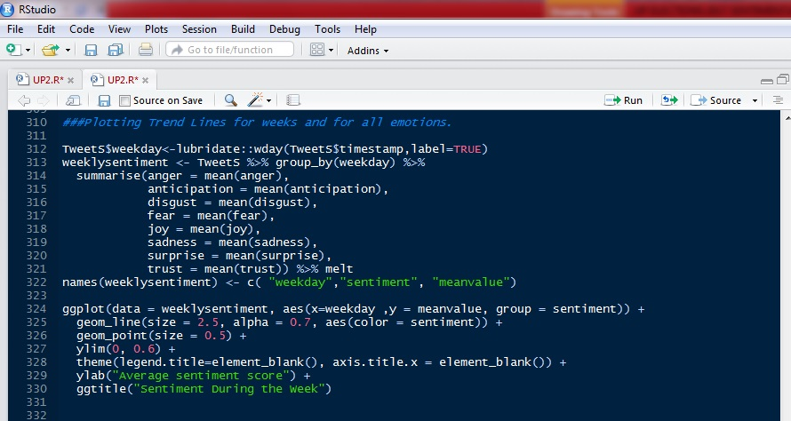
EMOTIONAL TRENDLINES :

Slide 12
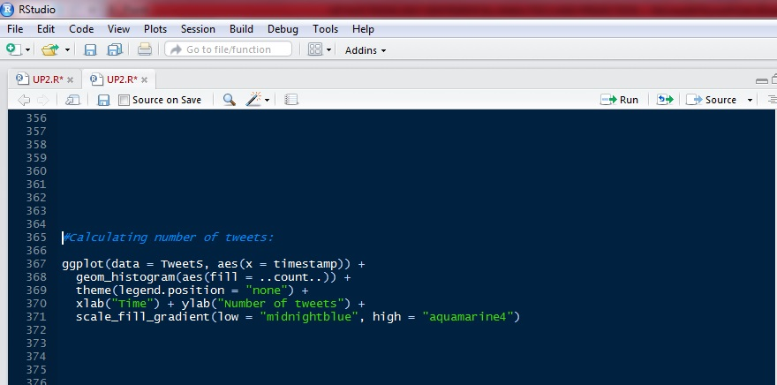
CALCULATING NUMBER OF TWEETS:

Slide 13
WORDCLOUD RESULTS

Slide 14
UP ELECTIONS :
This maps the sentimental shifts in the public perception for the UP Elections, indexed under #UPElections2017 and #UPPolls. Tweets are collected at differing intervals and their wordclouds are created. The following slides will contain the word clouds.

Slide 15
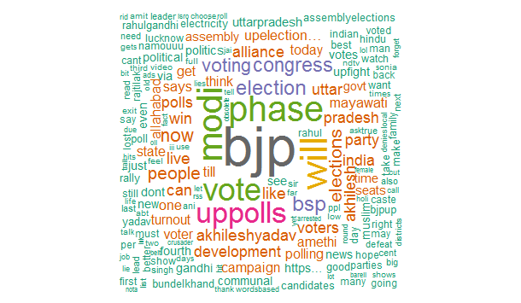
#UPElections2017
From the above word cloud, we see that “bjp” was the most frequently used string, which is indicative of people’s perception toward BJP and the fact that UP Elections and BJP have a prominent hold on people’s psyche. ‘modi”was also frequently mentioned in the tweets.

Slide 16
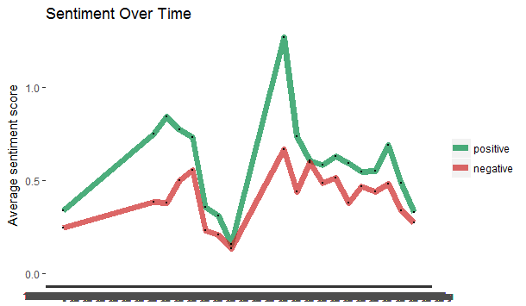
TRENDLINES :

Slide 17
@ANI NEWS UP
This maps the sentimental shifts in the public perception and news coverage for the UP Elections, indexed under #UPElections2017 and #UPPolls from the official ANI News UP twitter account. Tweets are collected at differing intervals and their wordclouds are created. The following slides will contain the word clouds.

Slide 18
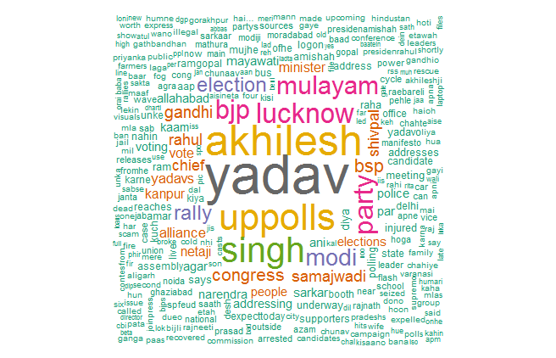
@ANI NEWS UP
From the above word cloud, it is evident that the incumbent party has been getting a lot of coverage, especially in the run-up to and during the elections. However, this maybe also attributable to the tussle within SP prior to the election.

Slide 19
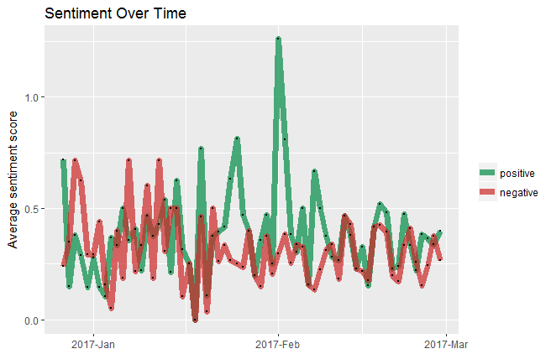
TRENDLINES (DAILY)
From the trend lines we see that the sentiment of the coverage during the elections by the news channel was overwhelmingly positive, if mapped on a daily basis.

Slide 20
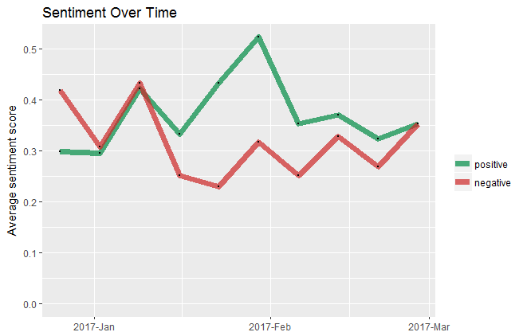
TRENDLINES (WEEKLY)
From the trend lines we see that the sentiment of the coverage during the elections by the news channel was overwhelmingly positive, if mapped on a daily basis. However, on weekly basis the emotions more or less negated each other.

Slide 21
BJP :
This maps the sentimental shifts in the public perception for BJP, during the UP Elections, indexed under #BJP4UP. Also, mapped are the sentiments of the face bearer of BJP , PM Narendra Modi by analyzing @narendramodi(official twitter account of PM Modi). Tweets are collected at differing intervals and their word clouds are created. The following slides will contain the word clouds.

Slide 22
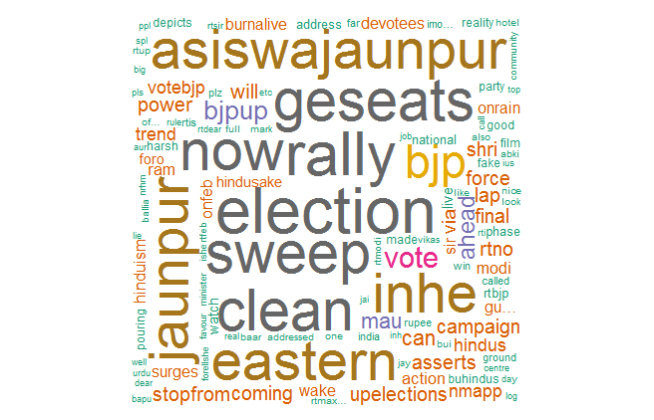
#BJP4UP
From the above word cloud we see that all the tweets indexed under, #BJP4UP reflects a high confidence regarding their chances in the ongoing election, as the words “election” and“sweep” are quite prevalent.

Slide 23
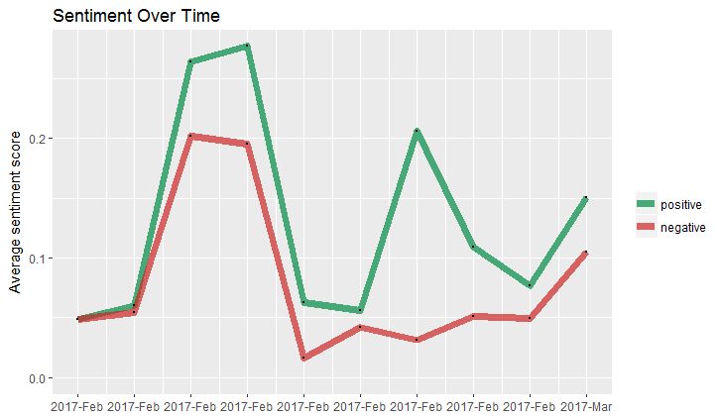
TRENDLINES :
From the above trend lines it is evident that during the peak of the election, the sentiment of the public using this hashtag was overwhelmingly positive and continues to remain so during the entire period. It is also registering a notable spike as the election reaches its final stretch.

Slide 24
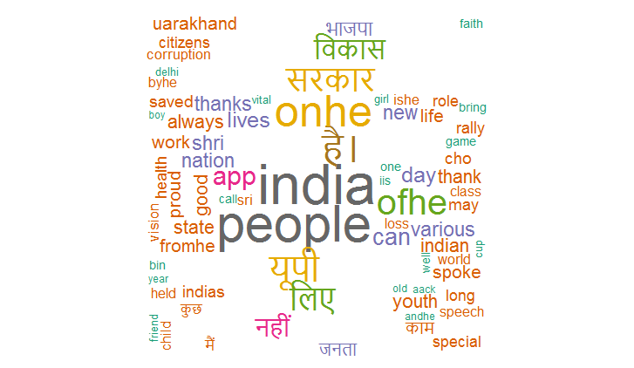
@narendramodi
From the above word cloud, we see that PM Modi is concerned about the country in general, as the strings “india” and “people” are the most prevalent. However, we see that he is also quite involved in the happenings of UP Elections 2017.

Slide 25
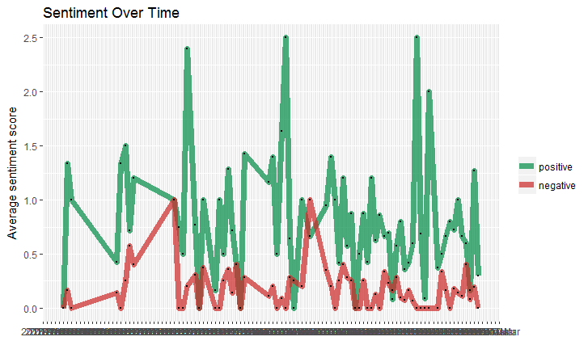
TRENDLINES : Daily

Slide 26
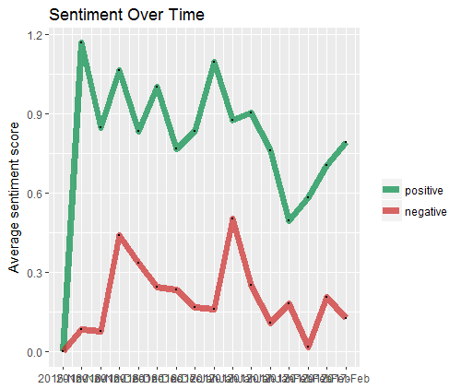
Weekly

Slide 27
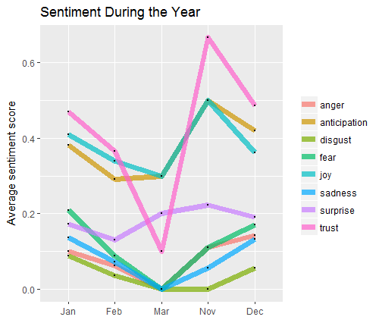
Modi User Emotions

Slide 28
SAMJWADI PARTY :
This maps the sentimental shifts in the public perception for the UP Elections, indexed under #SAMAJWADI PARTY and tweets from @yadavakhilesh, the official twitter account of CM Akhilesh Yadav. Tweets are collected at differing intervals and their word clouds are created. The following slides will contain the word clouds.

Slide 29
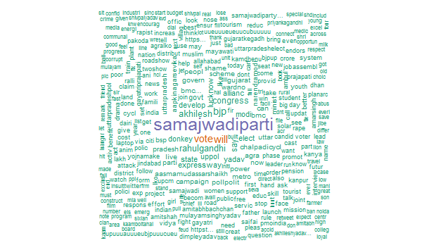
#SAMAJWADI PARTY
From the above word cloud we see that the hashtag has been receiving focused tweets in favor of the SP-Congress alliance, and also has minimal interference or influence from rival mentions.

Slide 30
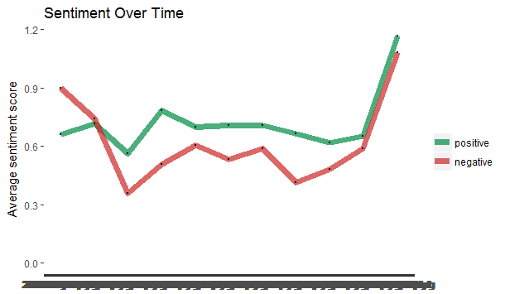
TRENDLINES :
The overall sentiment score of this hashtag remains positive and is seen spiking as the election progresses. This makes the SP-Congress alliance a strong contender.

Slide 31
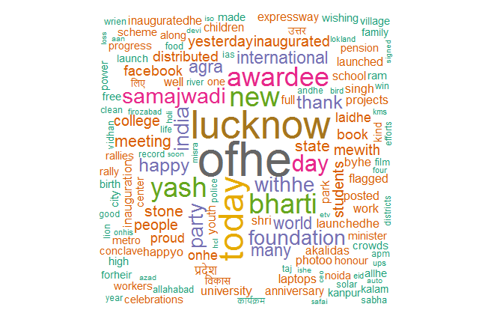
@yadavakhilesh
The tweets from CM Akhilesh Yadav seem to reiterate the promises made in his election manifesto without any explicit mention of the UP Elections.

Slide 32
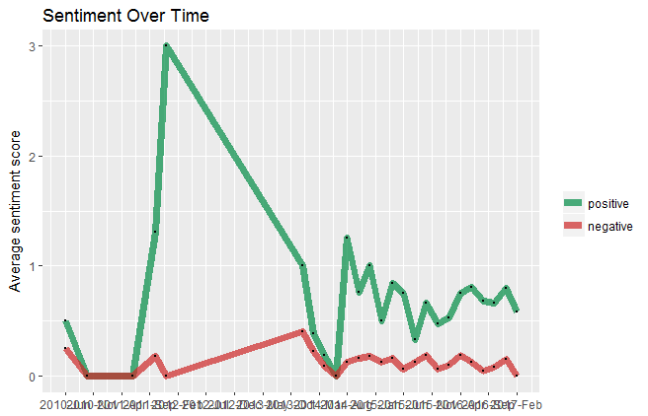
TRENDLINES :

Slide 33
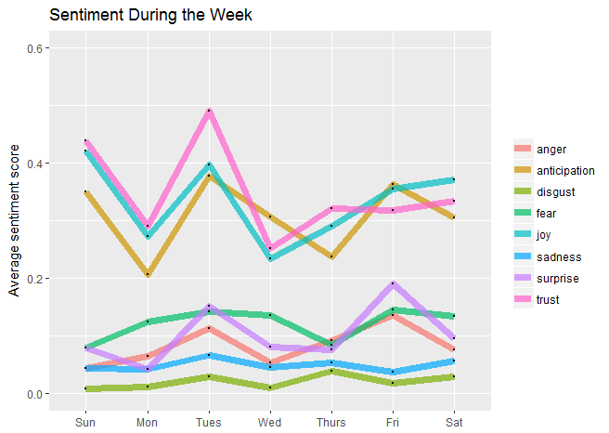
Akhilesh Emotions

Slide 34
BSP :
This maps the sentimental shifts in the public perception for the UP Elections, indexed under #BSP. Tweets are collected at differing intervals and their word clouds are created. The following slides will contain the word clouds as well as, the trendlines.

Slide 35
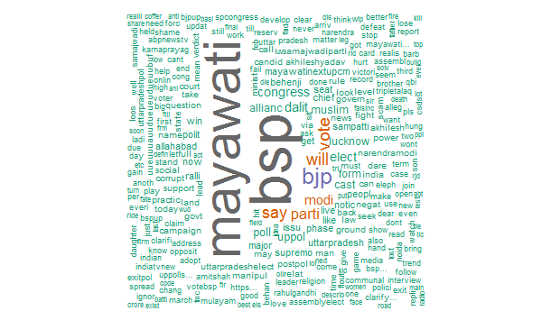
#BSP :
From the above word cloud, we see all the tweets indexed under #BSP and understandably, the strings “mayawati” and “bsp” are the dominant one’s. However, even here we see the prevalence of the strings “bjp” and “modi”.

Slide 36
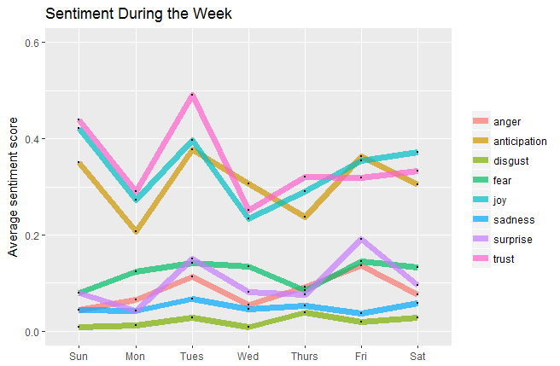
EMOTIONAL TRENDLINES :

Slide 37
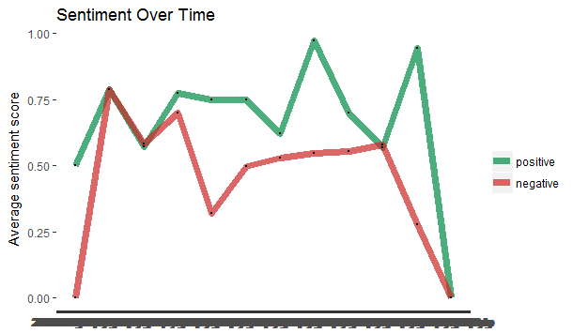
TRENDLINES :
From the above trend line for #BSP we see that the sentiments, both positive and negative have taken a steep downward slope, especially during the subsequent phases of the election, which leads us to conclude that its message is either not resonating or simply not getting through to the electorate. Thereby, rendering them not a serious contender.

Slide 38
TWEET FREQUENCY OF 2 MAIN LEADERS (MODI & AKHILESH )

Slide 39
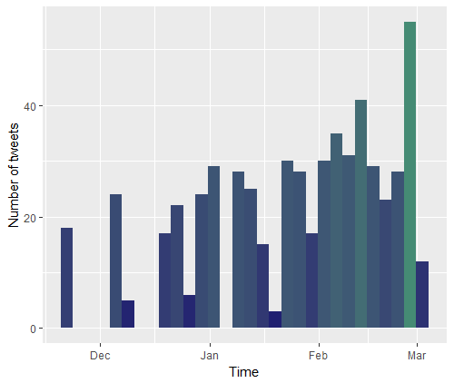
MODI :
PM Narendra Modi is known to be a tech savvy person and his reliance on social media is clearly evident from the frequency of his tweets which register a sharp spike during the months of February and March, the election months.

Slide 40
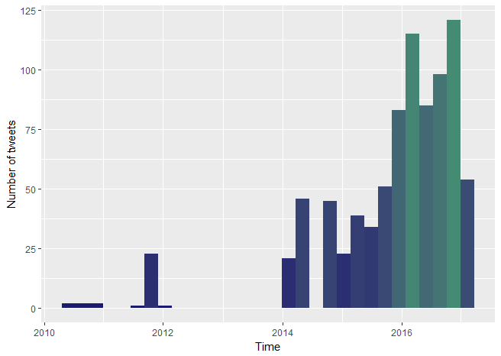
AKHILESH YADAV :
CM Akhilesh Yadav seems to be comparatively less tech savvy, however his tweets register a sharp spike in the run-up to to the election.

Slide 41
CONCLUSION:
From the above plotted trend lines we see that BJP has been gaining a lot of social media traction over its rivals: SP-Congress alliance and the BSP. Even though, we see that CM Akhilesh Yadav has been getting quite prevalent media coverage, we will still have to call this election in favor of BJP owing to their robust social media presence in both its own hashtags while also, featuring prominently on its rivals hashtags, which means that BJP has captured a major chunk of people’s psyche which boosts their electoral prospects.

